Slide 1
Paper Presentations
If you are presenting next week, please come and see us in office hours this week. Ideally, we would like to walk through your slides with you.
Each paper -- 25 mins of Paper Presentation + 5 mins Q/A

Slide 2
Guidelines for Paper Presentation
Motivation
Problem Statement
Summary of Contributions
Related Work
Preliminaries + Background (Intuition First!)
Approach (Intuition First!)
Key Experimental Results
Conclusions
Your Perspective on the Weaknesses of Paper
What would you do differently?

Slide 3
Generalized Additive Models

Slide 4
Intelligible Models for HealthCare
Caruana et. al.

Slide 5
Contributions
Two case studies where Generalized Additive Models (intelligible) yield state-of-the-art accuracy.
Pneumonia risk prediction
30-day hospital readmission
Claim: GAMs is a class of models that can handle interpretability/accuracy trade-off quite well

Slide 6
Roadmap
Motivation
Intelligible Models
Case study: Pneumonia risk
Case study: 30 day readmission

Slide 7
Roadmap
Motivation
Intelligible Models
Case study: Pneumonia risk
Case study: 30 day readmission

Slide 8
Motivation
A large project to evaluate application of ML to healthcare problems
Predicting probability of death (POD) for pneumonia patients
Most accurate models: neural nets (0.86 AUC)
Logistic regression: 0.77
Logistic regression was used instead. Why?

Slide 9
Motivation
Rule based learning method was also used
Insight: HasAsthma(x) → LowerRisk(x)
Counterintuitive?
Rule based system was intelligible making it easy to recognize and remove dangerous rules
Lack of intelligibility made it harder to deploy neural nets because it was difficult to know other problems with the model

Slide 10
Motivation
Many more models but equally unintelligible today
SVMs, random forests, boosted trees
GAMs are both intelligible and accurate!
Editable by experts

Slide 11
Roadmap
Motivation
Intelligible Models: GAMs and GA²MS
Case study: Pneumonia risk
Case study: 30 day readmission

Slide 12
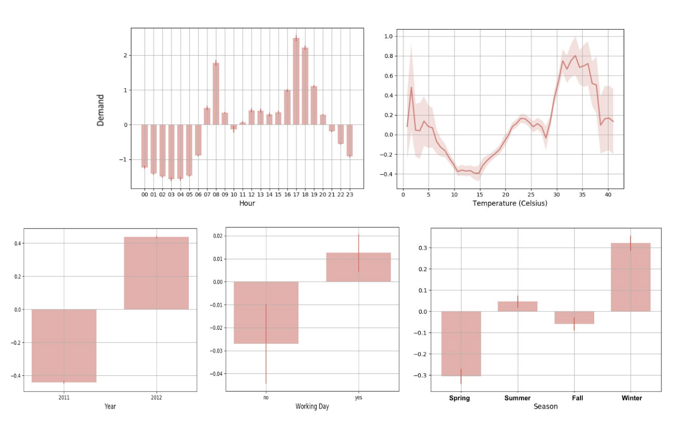
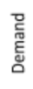
GAMs

Slide 13
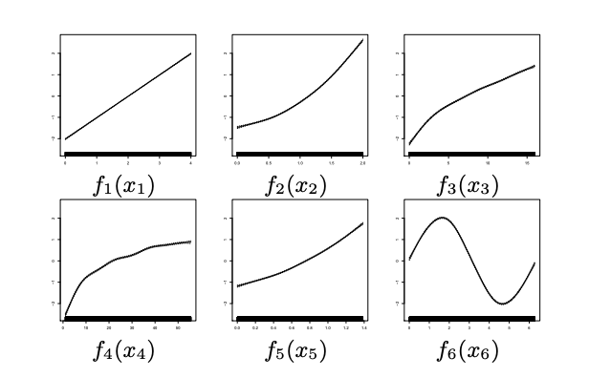
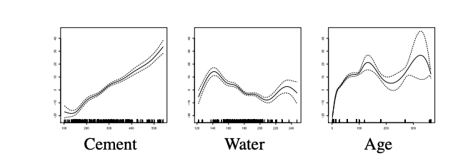
GAMs

Slide 14
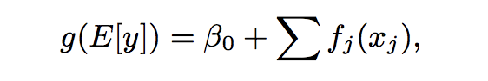
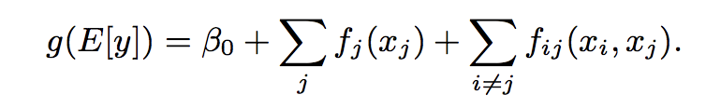
GAMs and GA²Ms
g is a link function: identity (additive model e.g., regression);
log (E[y] / 1 – E[y]) (generalized additive model e.g., classification)
f_{j} is a shape function

Slide 15
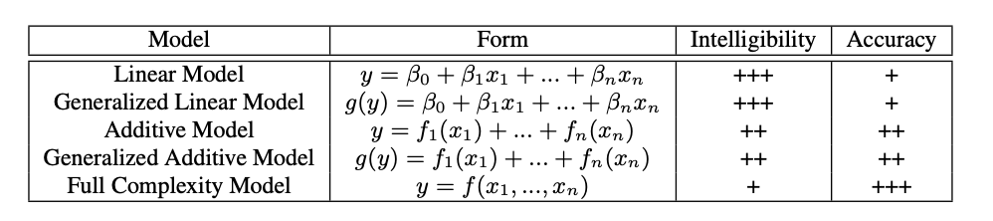
Intelligibility and Accuracy
Lou et. al., 2012

Slide 16
Shape Functions
Regression Splines
Trees
Ensembles of Trees

Slide 17
GAMs and GA²Ms
Learning:
Represent each component as a spline
Least squares formulation; Optimization problem to balance smoothness and empirical error
Regression trees on a single/pair of features
Gradient boosting with bagging of shallow trees
GA²Ms: Build GAM first and and then detect and rank all possible pairs of interactions in the residual
Choose top k pairs
k determined by CV

Slide 18
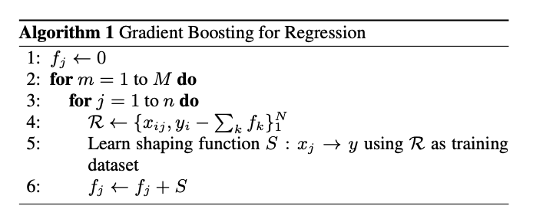
M: number of iterations; n: number of features (and shape functions)

Slide 19
Roadmap
Motivation
Intelligible Models
Case study: Pneumonia risk
Case study: 30 day readmission

Slide 20
Pneumonia Risk
14,199 pneumonia patients
train set: 9847
test set: 4352
46 features
Predict POD
10.86% patients died from pneumonia (1542)

Slide 21
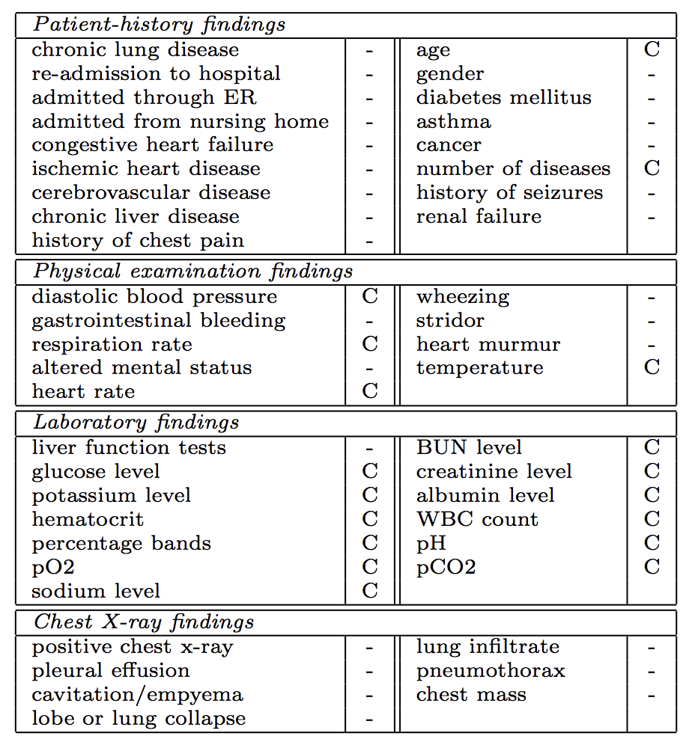
Pneumonia Risk: Features

Slide 22
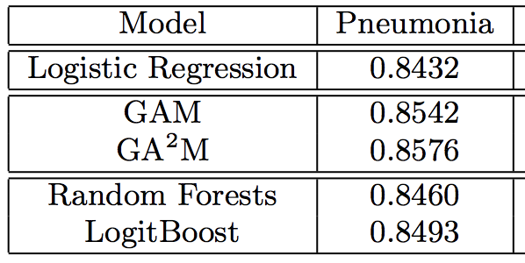
Pneumonia Risk: AUC

Slide 23
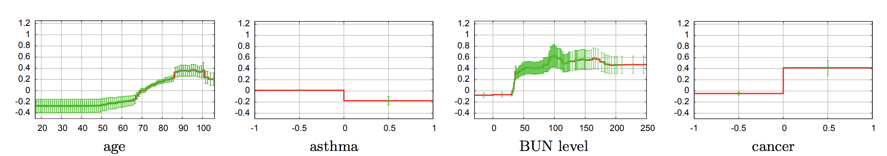
Understanding Outputs of GA²M
Blood Urea Nitrogen
Normal value: 10 to 20
0 means not ordered

Slide 24
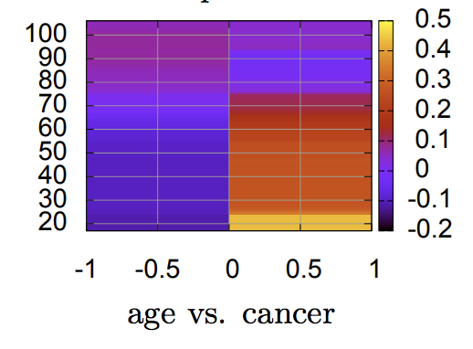
Understanding Outputs of GA²M
Childhood cancers are associated with high risk of death

Slide 25
Roadmap
Motivation
Intelligible Models
Case study: Pneumonia risk
Case study: 30 day readmission

Slide 26
30 day readmission
195K patients in train, 100K patients in test
3956 features
Predict which patients are likely to be readmitted within 30 days of being released
Hospitals with high readmission rates are penalized financially
Did not provide adequate care earlier
8.91% of patients readmitted within 30 days

Slide 27
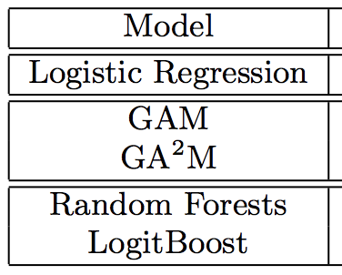
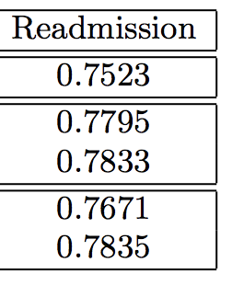
AUC

Slide 28
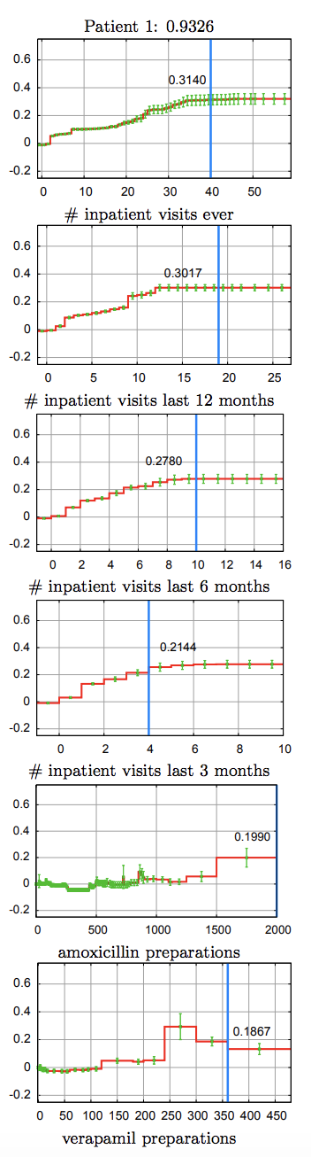
Patient level insights
Lots of admissions
Received lot of
Amoxycilin (strep/pneumonia)
3. Verapamil (hypertension)
p(risk) = 0.9326

Slide 29
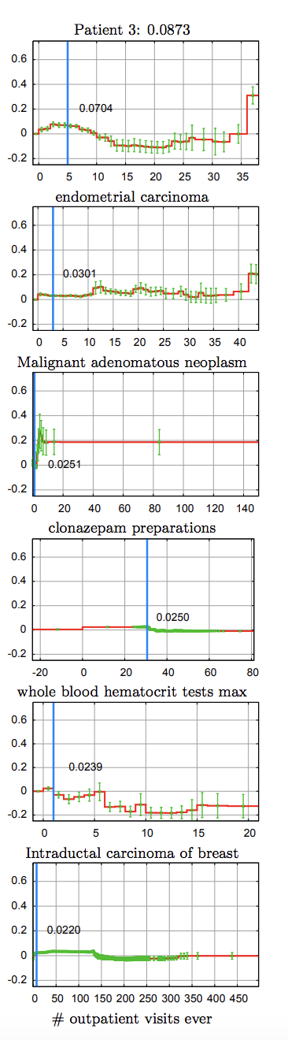
Patient level insights
Lots of admissions
Received lot of
Amoxycilin (strep/pneumonia)
3. Verapamil (hypertension)
1. Post menopausal
2. Cancers that
respond well to treatment
3. Not hospitalized much
p(risk) = 0.9326
p(risk) = 0.0873

Slide 30
Roadmap
Motivation
Intelligible Models
Case study: Pneumonia risk
Case study: 30 day readmission

Slide 31
How to Interpret Risk Scores?
Each term returns a risk score
Probability = 1/(1 + exp(-1 * total risk score))
Pneumonia and 30 day readmission have baseline rates near 0.1 → baseline risk score = -2.197
Patients above baseline risk have higher probability of death/readmission

Slide 32
Modularity
Bias term + contributions of individual features + contributions of pairwise interactions
This structure helps us clearly understand the model

Slide 33
Sorting Terms By Importance
For each patient, we can compute which term is resulting in what risk score
Rank terms based on the values of risk score
This ranking tells us which features are contributing to the risk of each patient

Slide 34
Feature Shaping vs. Expert Discretization
Instead of GAMs learning function shapes, experts could also provide inputs by discretizing features
Expert discretized features were used for logistic regression model
However, GAMs outperformed LR indicating that feature shaping is valuable

Slide 35
Correlation != Causation
GAMs and GA²Ms are intelligible
But, they are not causal
What we see in plots are associations captures from the data but are not causal implications
It is often easy to confuse intelligibility of predictive models with causality
Please don’t make that mistake!

Slide 36
Prototype Based Approaches

Slide 37
Deep Learning for Case-Based Reasoning through Prototypes
Oscar Li, Hao Liu, Chaofan Chen, Cynthia Rudin

Slide 38
Contributions
Proposed and developed a novel network architecture for deep learning
Explains its own reasoning for each prediction
Not post-hoc explanations
Prototypes learned during training
Explanations are faithful to what the network computes

Slide 39
Motivation
ML models are increasingly deployed to answer societal questions → interpretability/transparency
Radiology: Lack of transparency poses challenges to FDA approval for deep learning models
Neural nets are particularly difficult to understand because of the high degree of non-linearity

Slide 40
Related Work: Post-hoc explanations
Past: neural nets designed mainly for accuracy with post-hoc explanations
Build neural net first, then interpret!
Problem: post-hoc explanations may not be faithful to the model
Easy to create multiple conflicting yet convincing explanations, none of which is correct

Slide 41
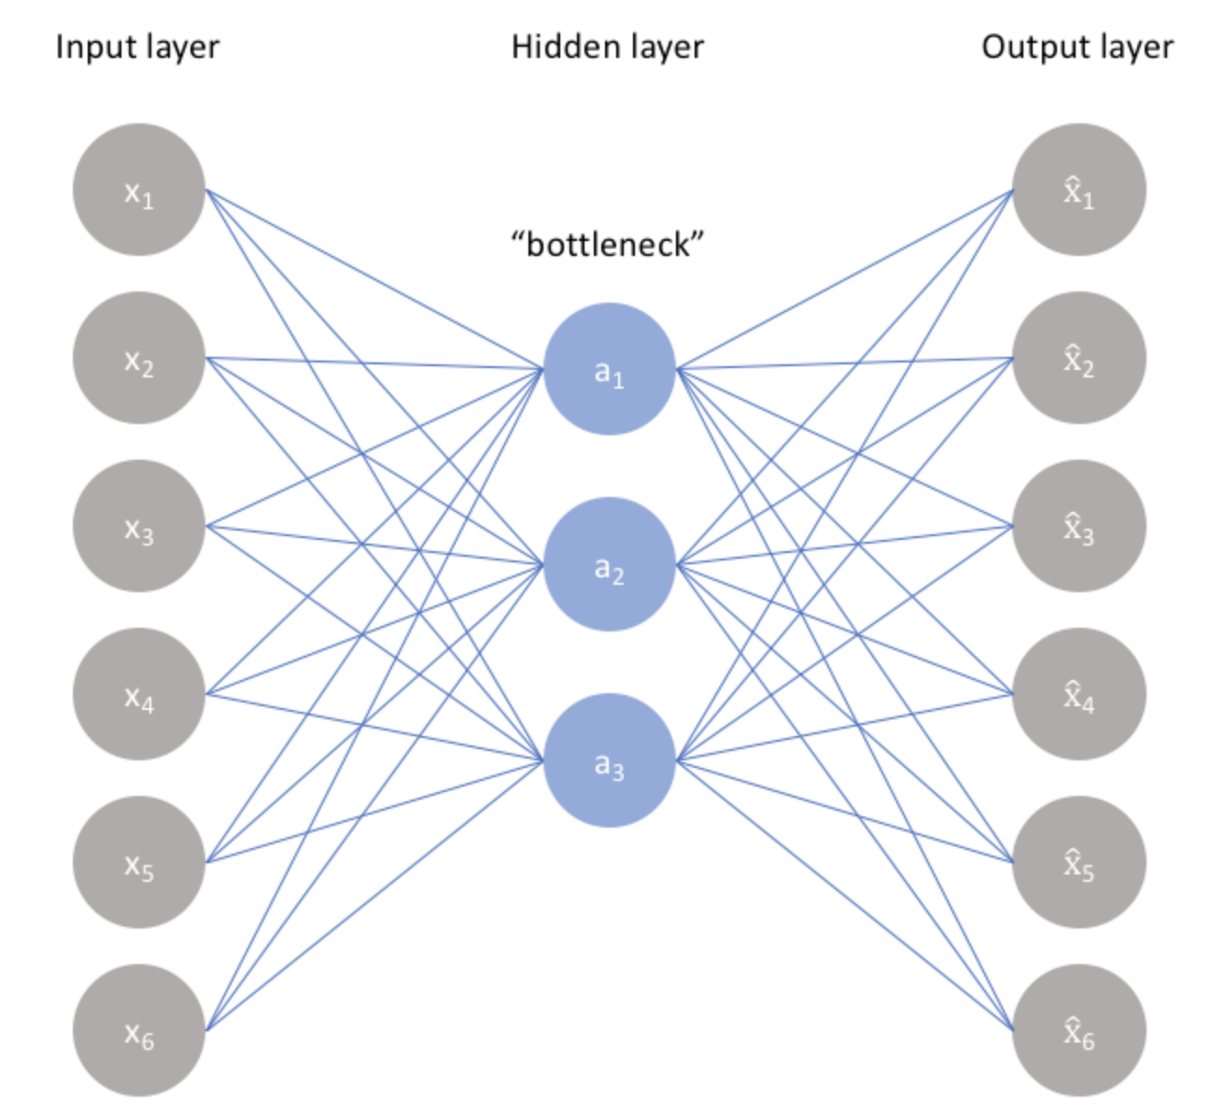
Background: Autoencoder
Non-linear Dimensionality Reduction and Reconstruction

Slide 42
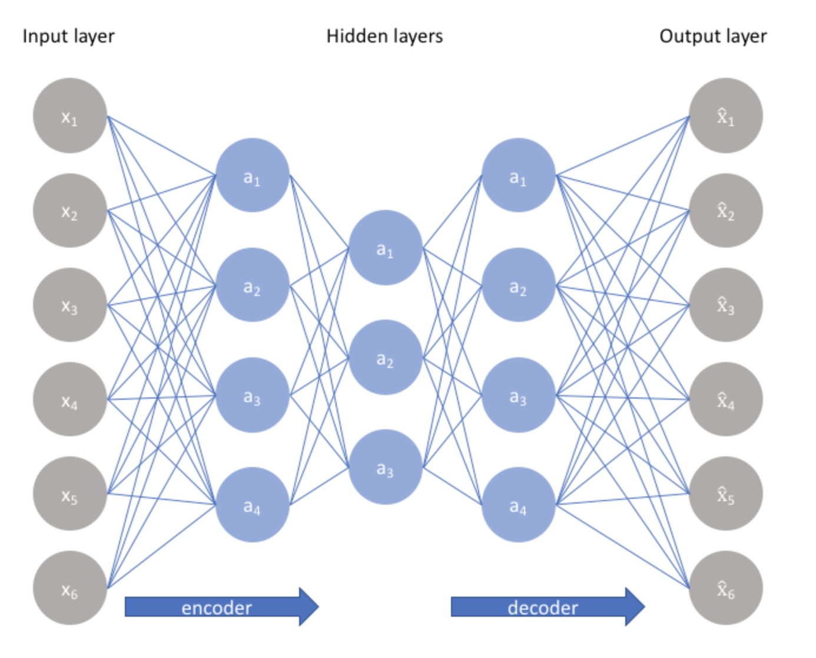
Background: Autoencoder

Slide 43
Background: Constructing an Autoencoder
Constrain the number of nodes present in the hidden layer(s) of the network,
limiting the amount of information that can flow through the network
By penalizing the network according to the reconstruction error, our model can learn the most important attributes of the input data and how to best reconstruct the original input from an "encoded" state.
The encoding will learn and describe latent attributes of the input data.

Slide 44
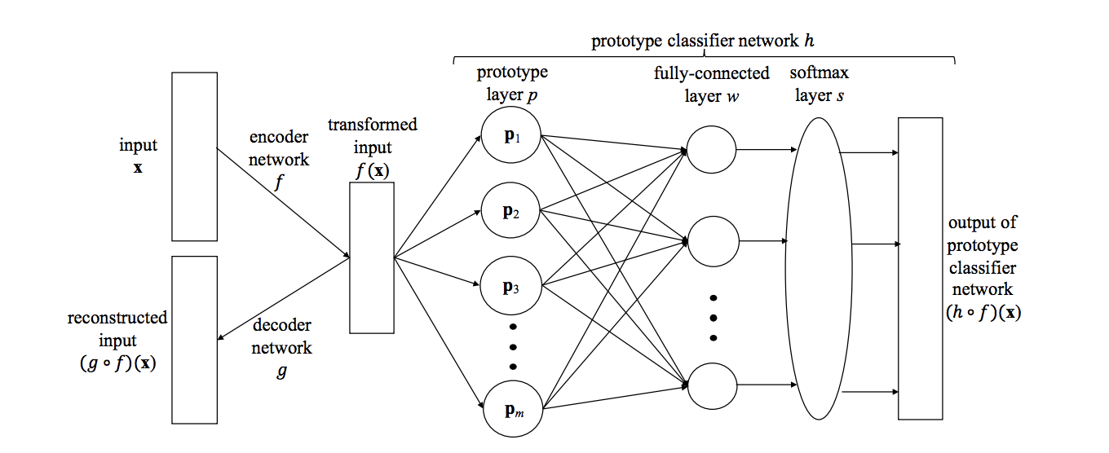
Proposed Network Architecture
Autoencoding

Slide 45
Autoencoder
R^{p}
R^{q}
q < p
R^{p}
Autoencoding

Slide 46
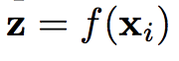
Prototype Layer
R^{p}
R^{q}
q < p
R^{p}
R^{m}
Prototype layer is responsible for computing the following:
Each node in layer p computes one of the above elements

Slide 47
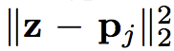
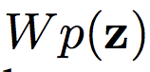
Fully Connected Layer
The fully connected layer computes weighted sums of the distances :
W is a k x m matrix
R^{p}
R^{q}
q < p
R^{p}
R^{m}
R^{k}

Slide 48
Softmax Layer
R^{p}
R^{q}
q < p
R^{p}
R^{m}
R^{k}
R^{k}
The weighted sums are normalized by the softmax layer to output
a probability distribution over K classes

Slide 49
Few points
With the above model, there could be more than one prototype per class
What if we want only one prototype per class?

Slide 50
Advantages of Proposed Architecture
Automatically learns useful features
Non-linear dimensional reduction
Suitable for high-dimensional data such as images
Prototypes vectors can be decoded and visualized
Same latent space as encoded inputs
Ability to interpret without post-hoc analysis

Slide 51
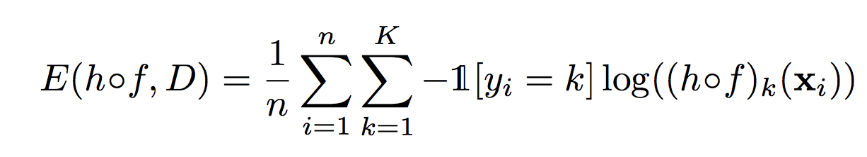
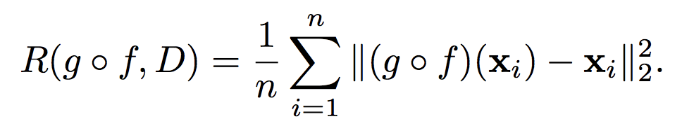
Cost Function
Cross entropy loss
Reconstruction error

Slide 52
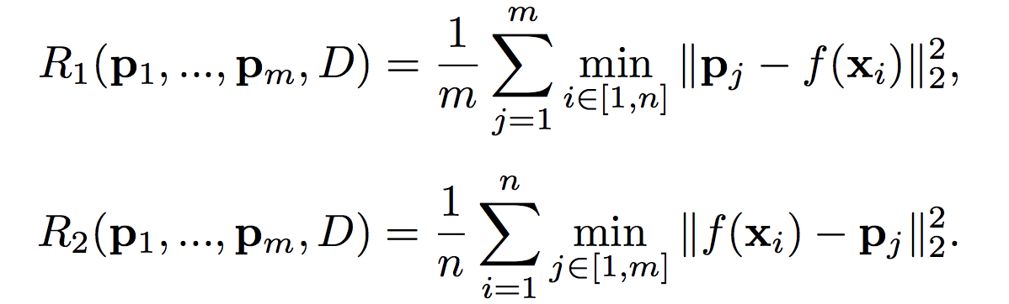
Cost Function: Interpretability Regularizers
Each prototype vector should be as close as possible
to at least one training example
Each training example should be as close as
possible to one prototype

Slide 53
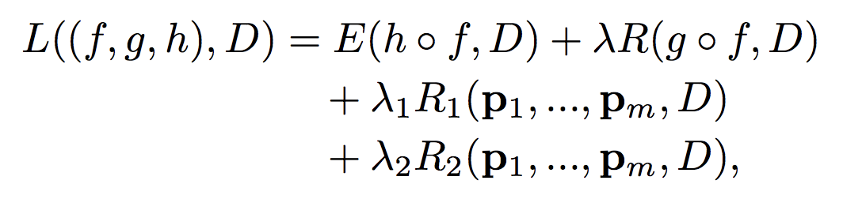
Cost Function

Slide 54
Neural Networks
Step 1: Define architecture
Step 2: Outline cost function
Step 3: Forward pass, compute derivatives, back propagate, update parameters – repeat!
Min functions are not technically differentiable
But, in practice, packages allow it
This is essentially gradient descent

Slide 55
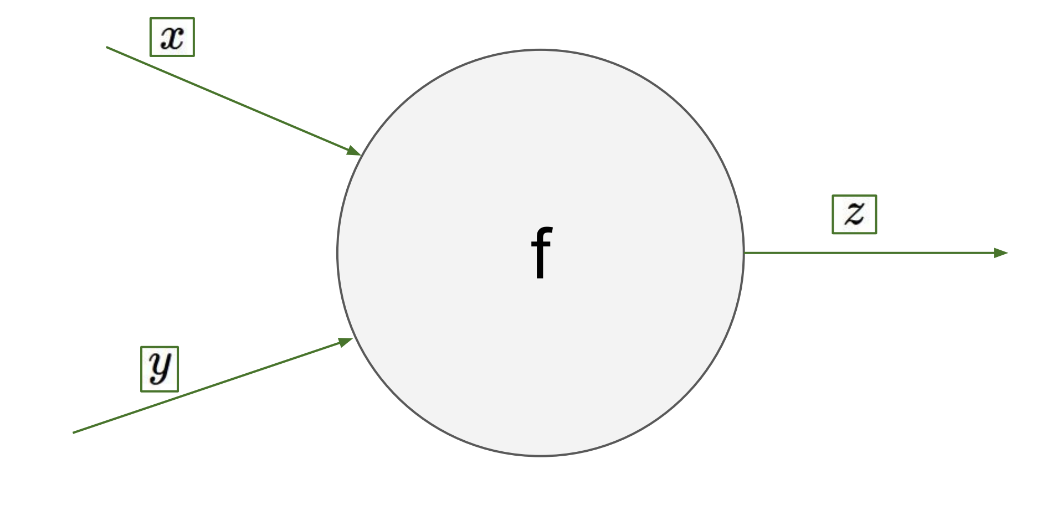
Backpropagation: Intuition

Slide 56
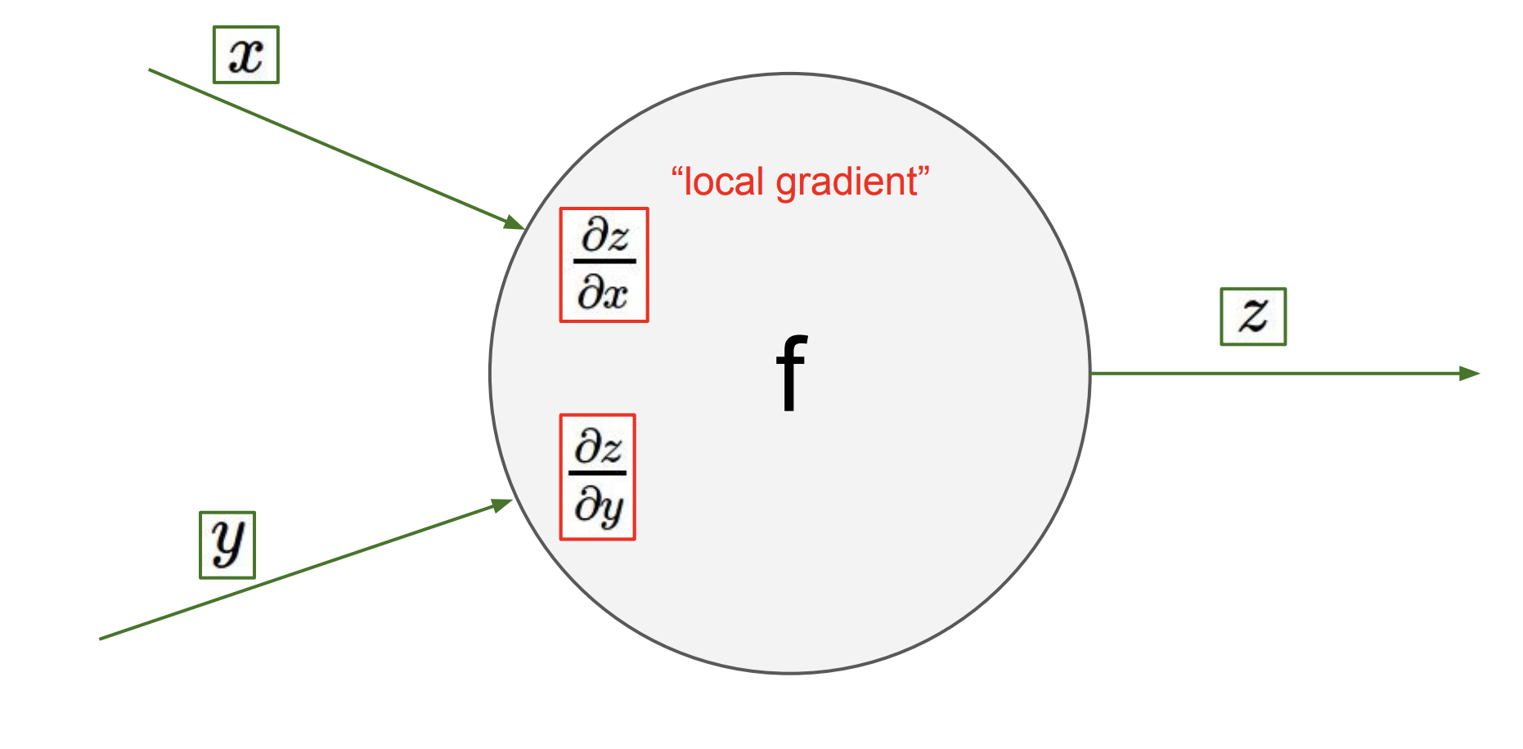
Backpropagation: Intuition

Slide 57
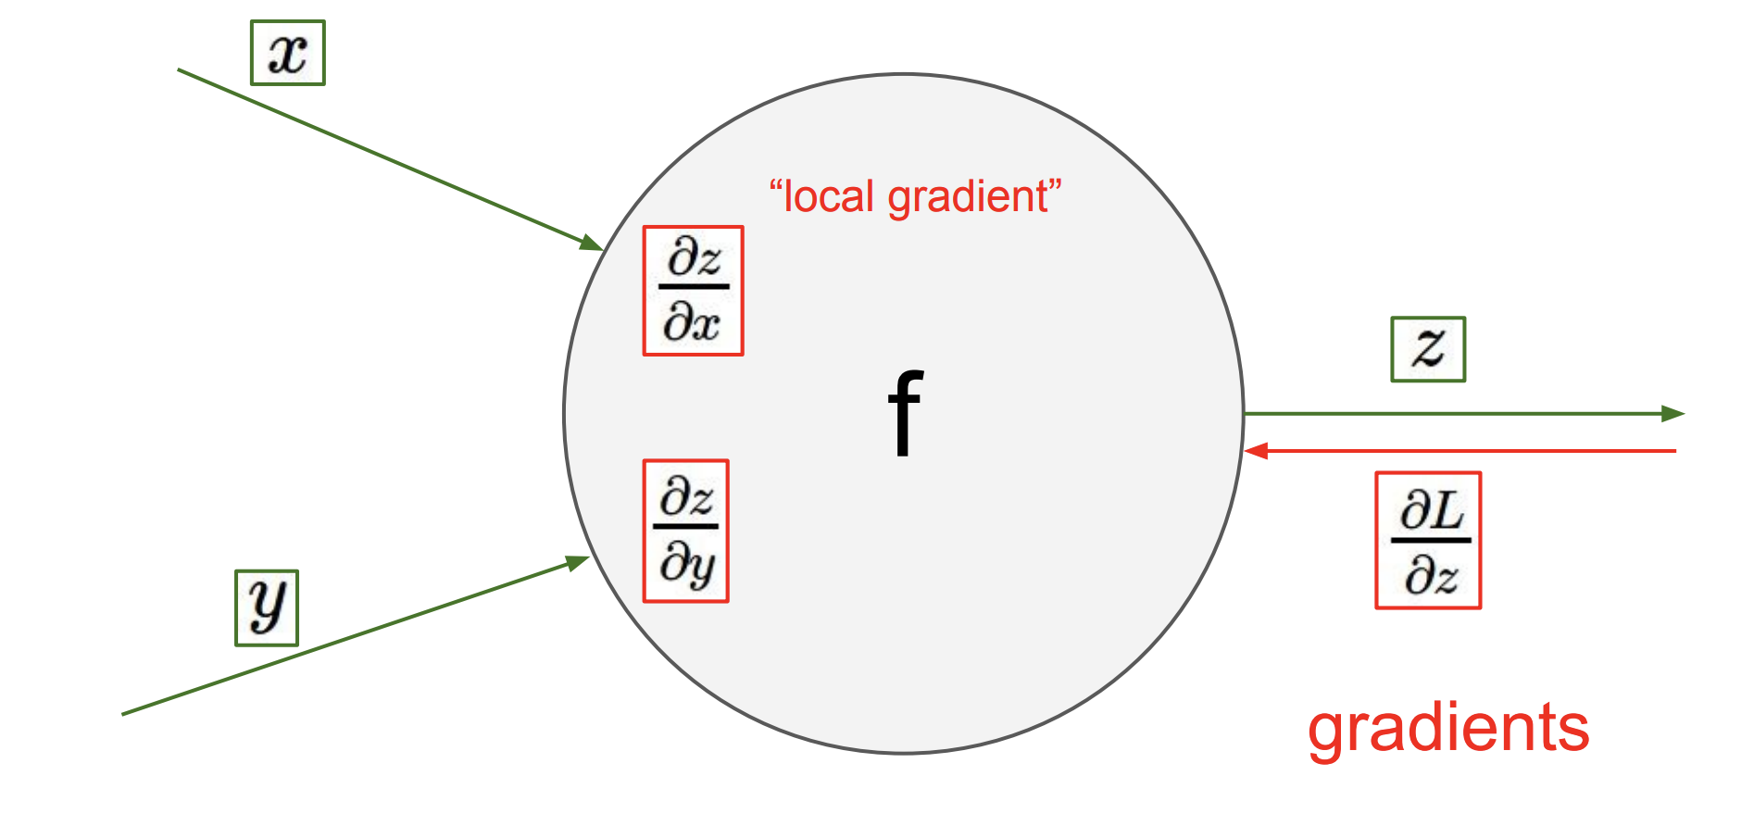
Backpropagation: Intuition

Slide 58
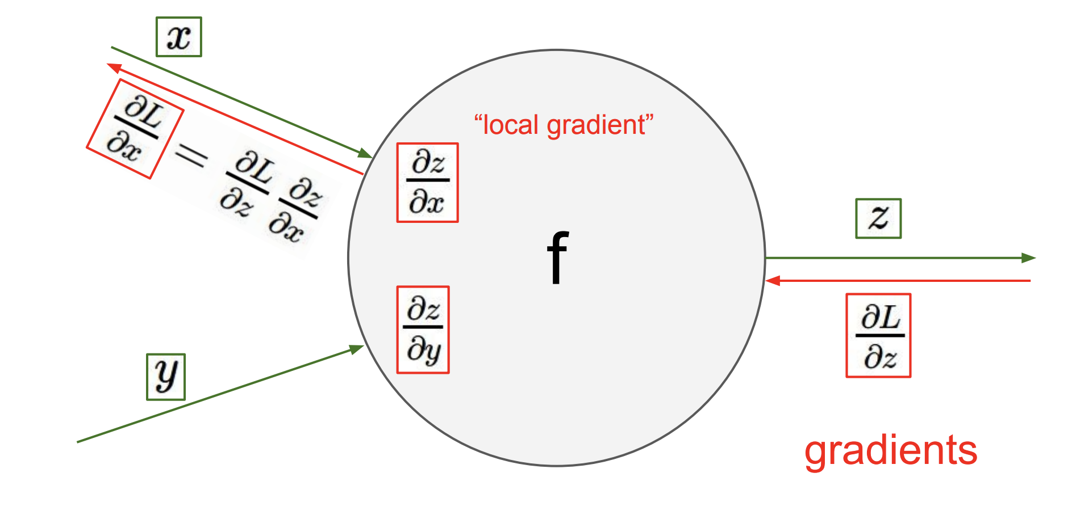
Backpropagation: Intuition
Local gradient x upstream gradient

Slide 59
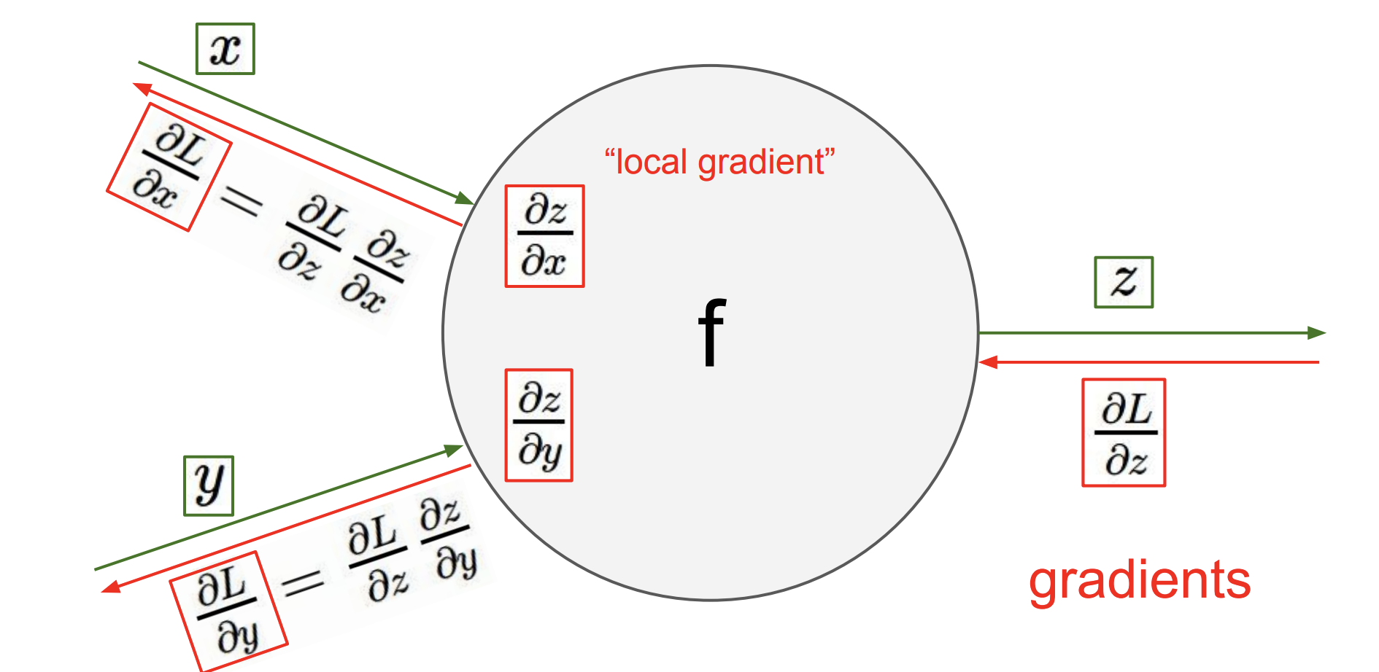
Backpropagation: Intuition
Local gradient x upstream gradient

Slide 60
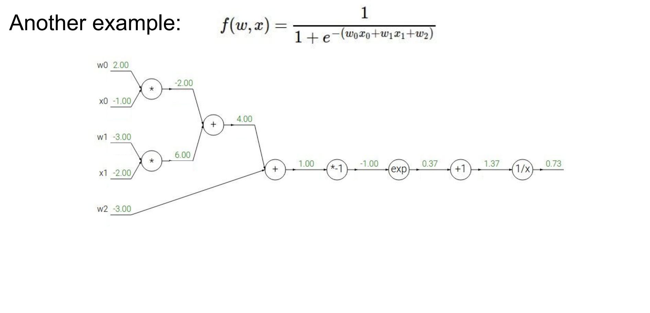
Backpropagation: Example

Slide 61
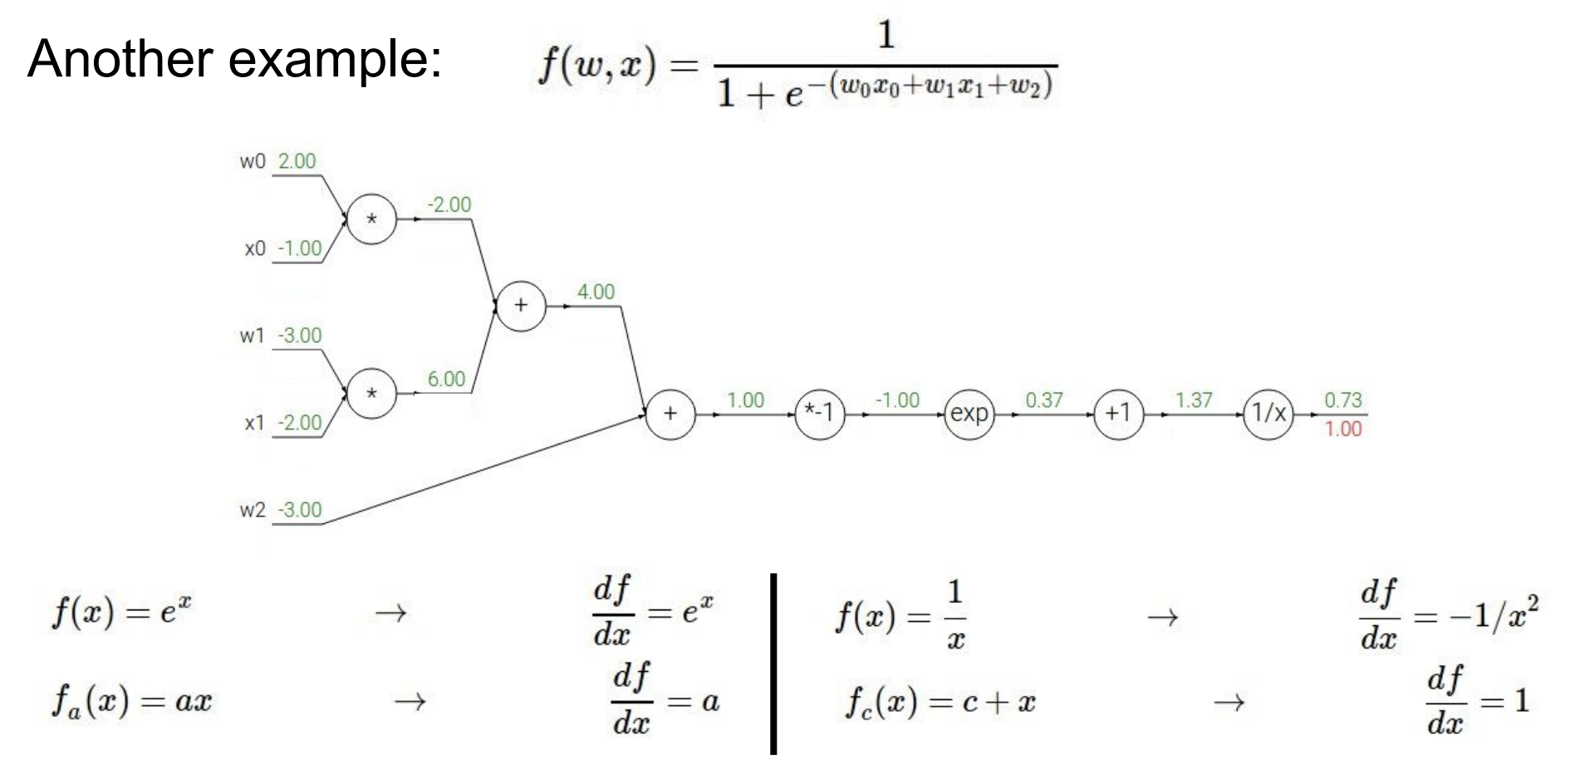
Backpropagation: Example

Slide 62
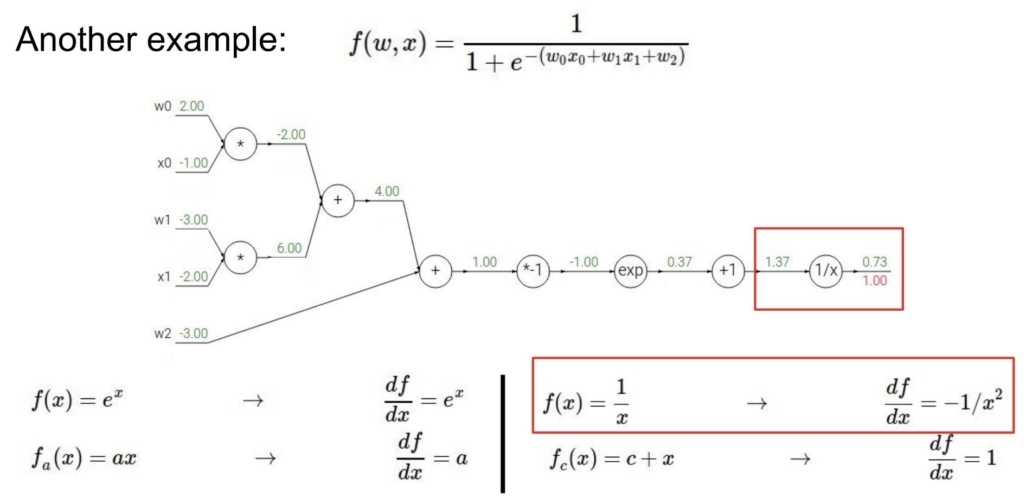
Backpropagation: Example

Slide 63
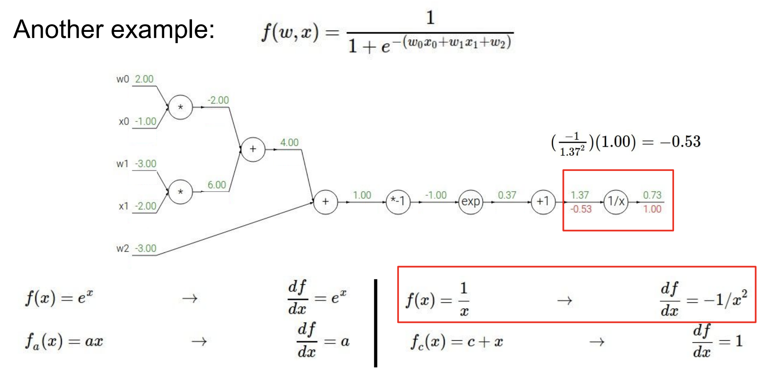
Backpropagation: Example

Slide 64
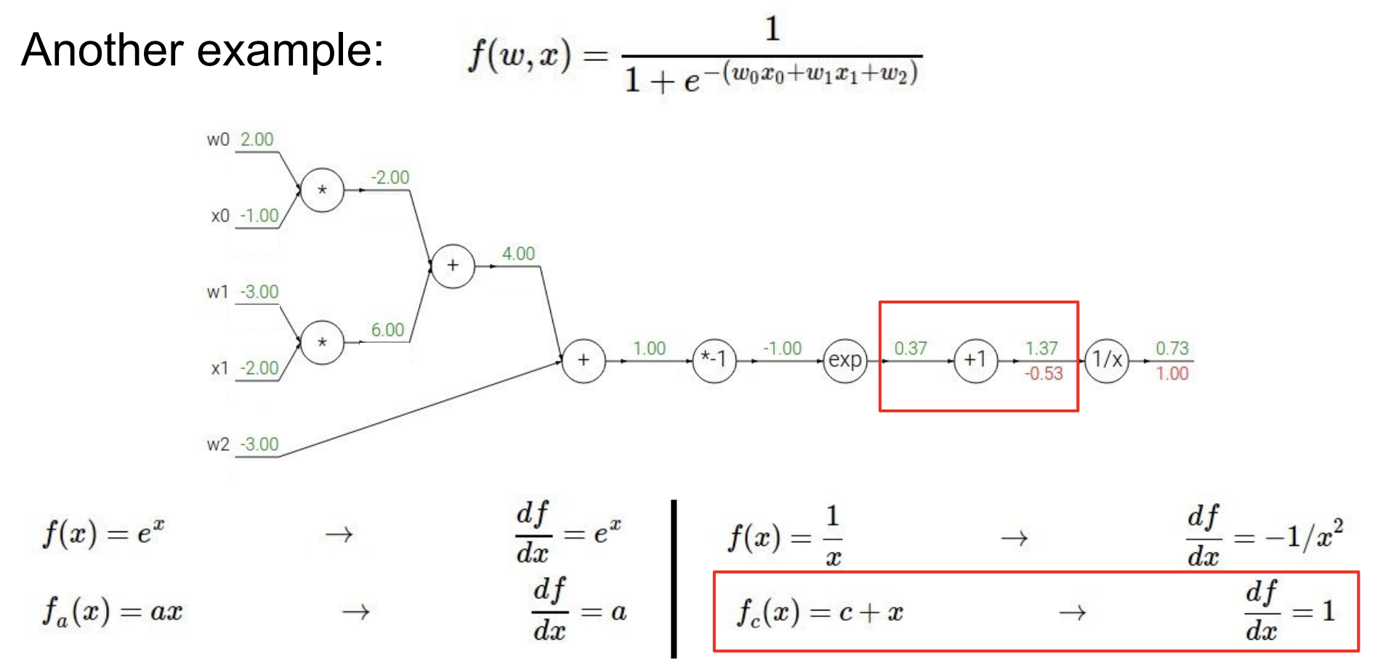
Backpropagation: Example

Slide 65
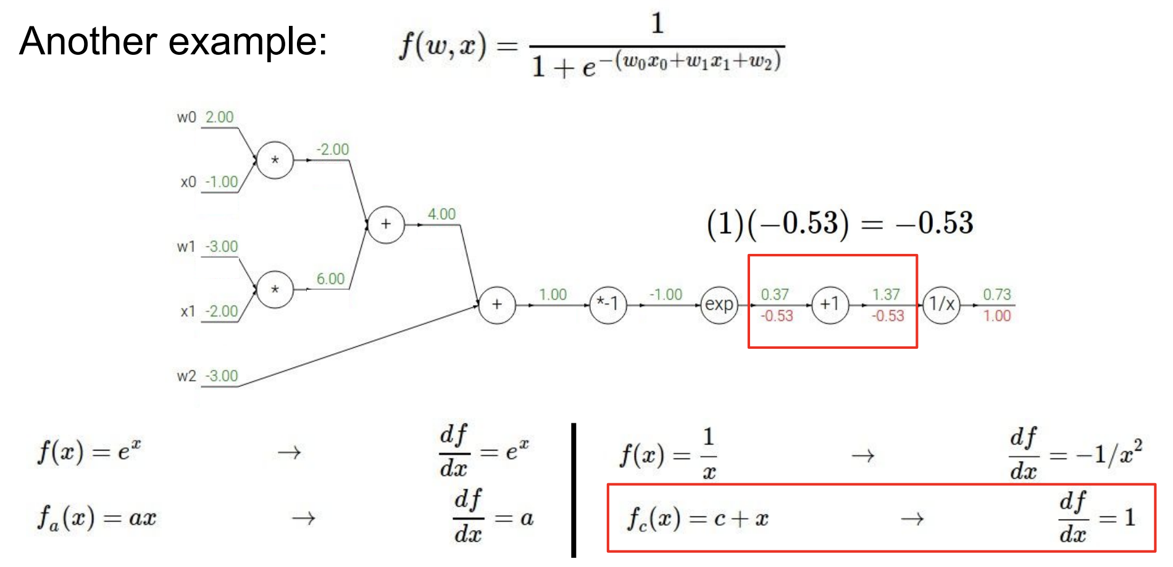
Backpropagation: Example

Slide 66
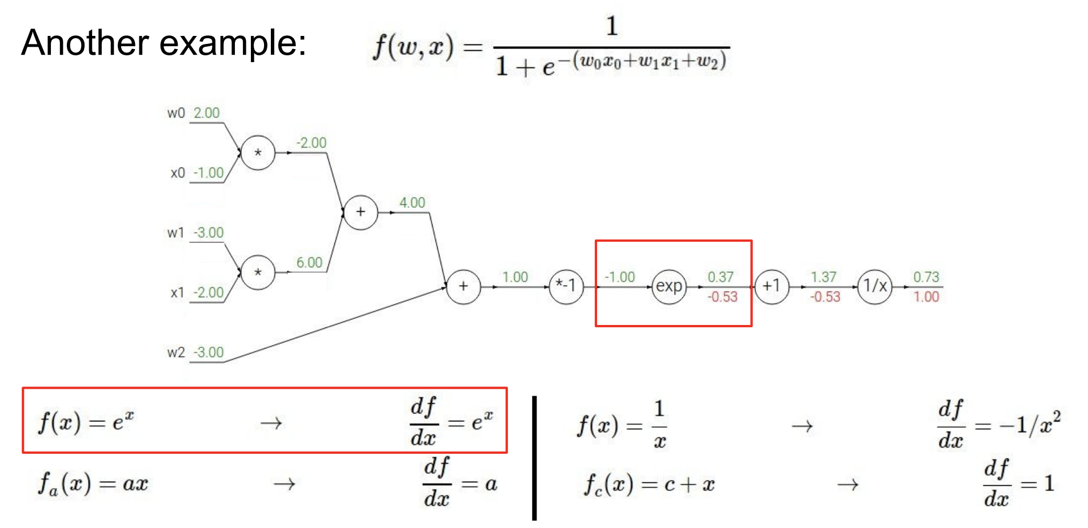
Backpropagation: Example

Slide 67
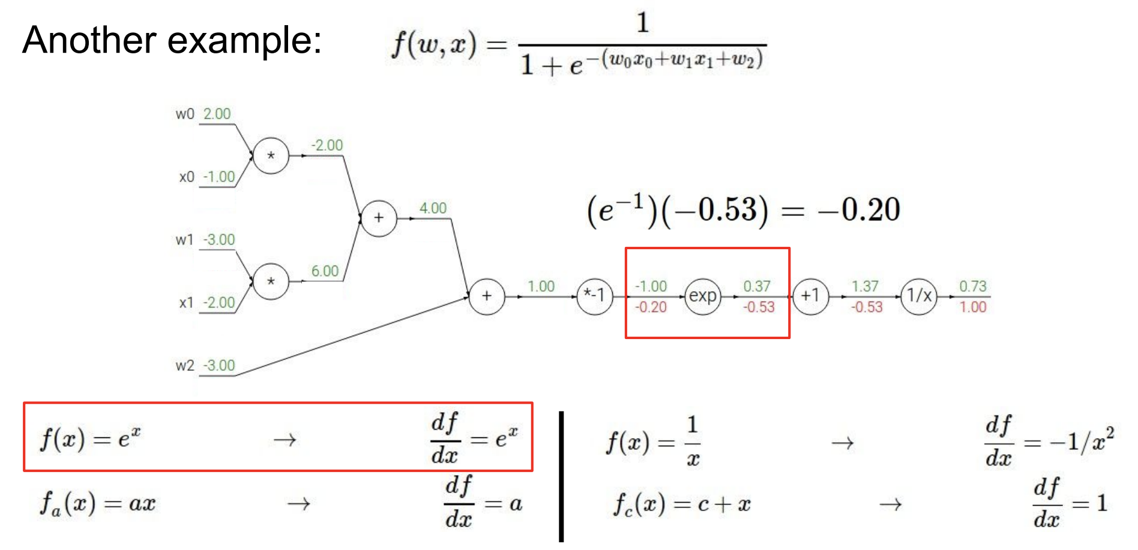
Backpropagation: Example

Slide 68
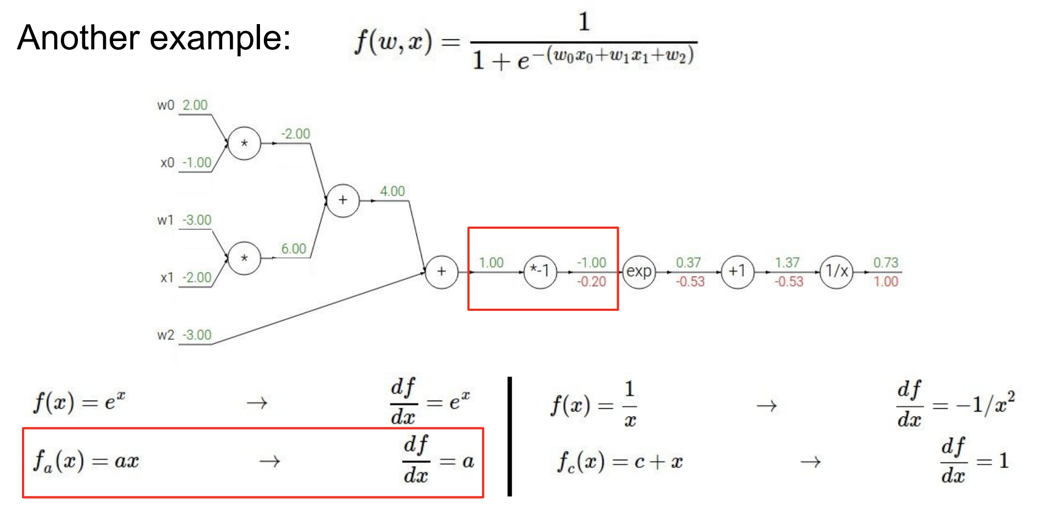
Backpropagation: Example

Slide 69
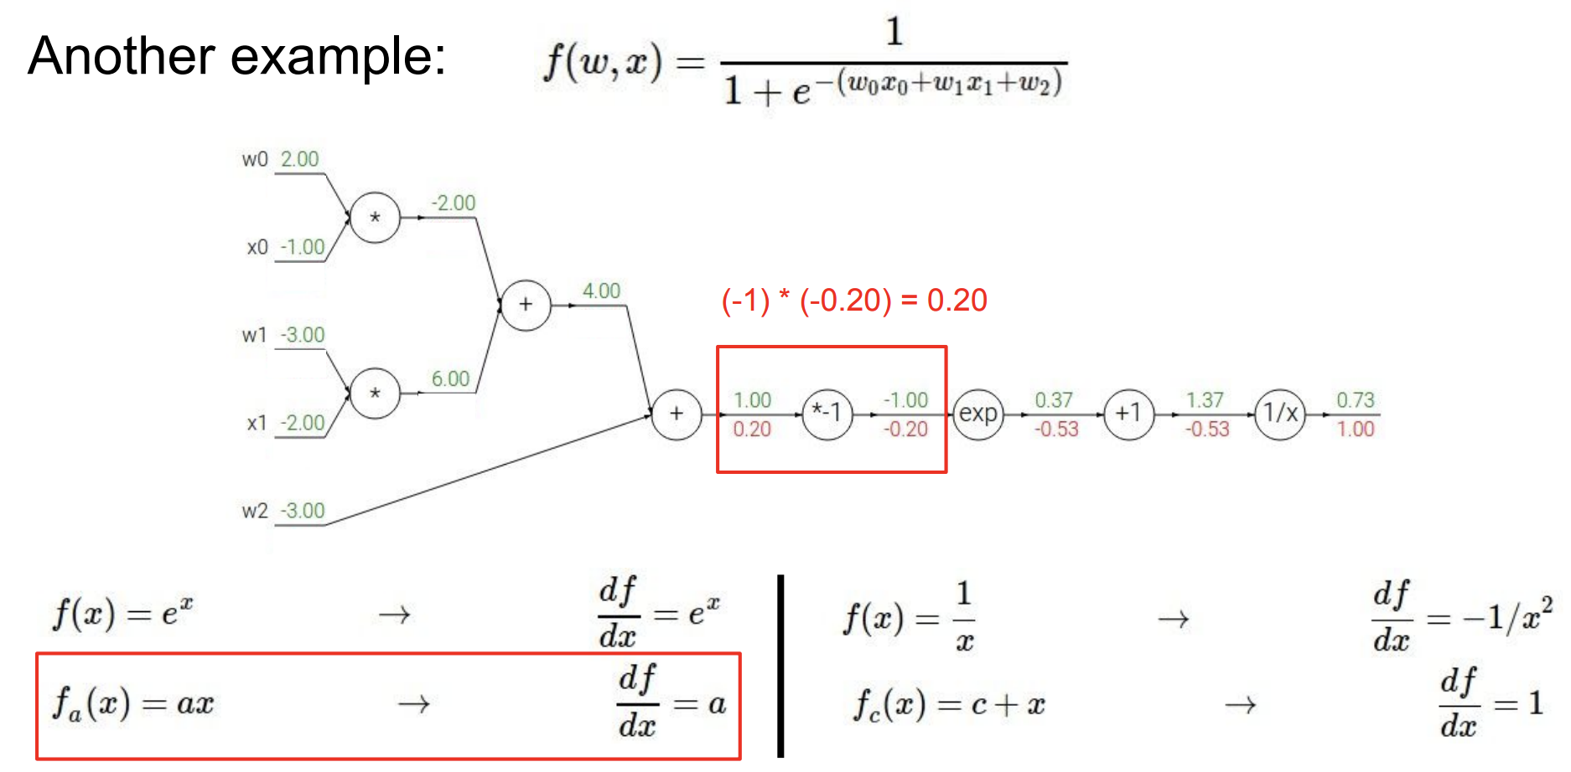
Backpropagation: Example

Slide 70
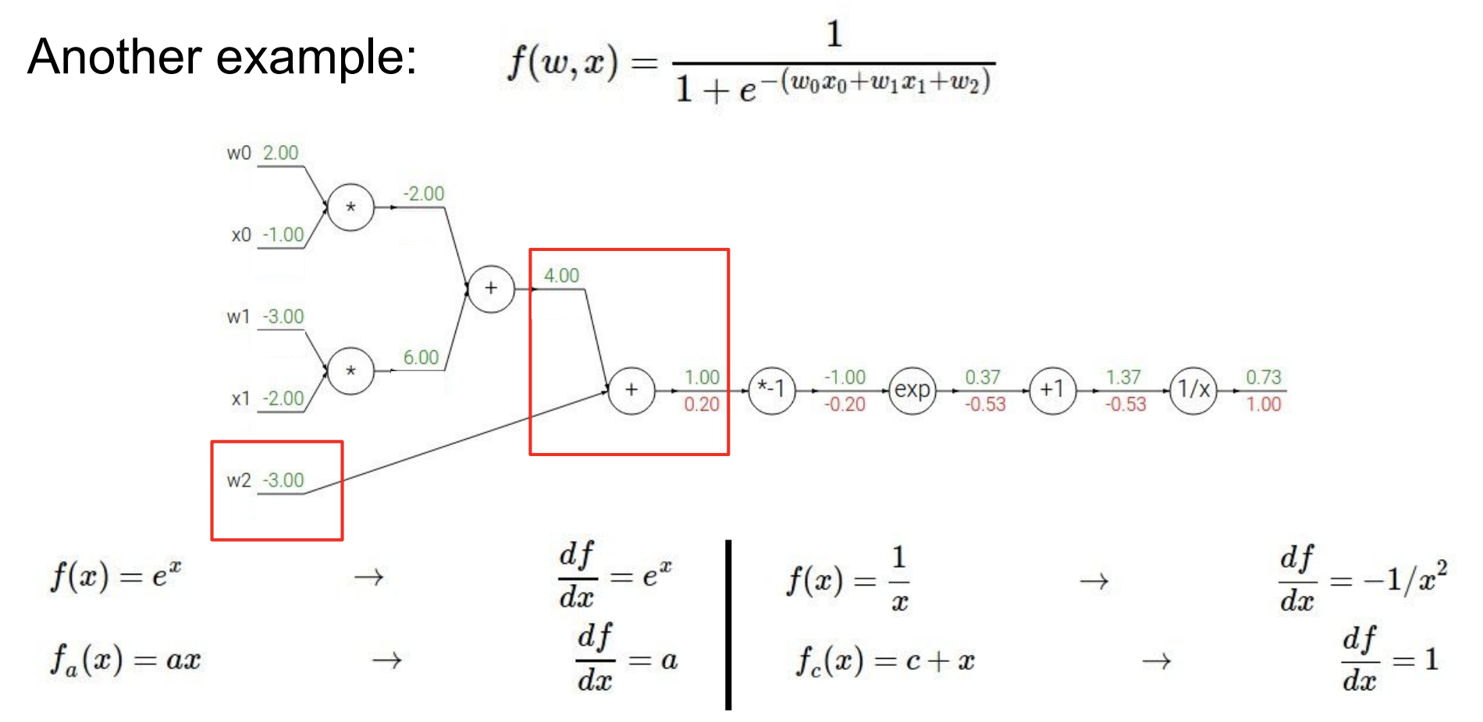
Backpropagation: Example

Slide 71
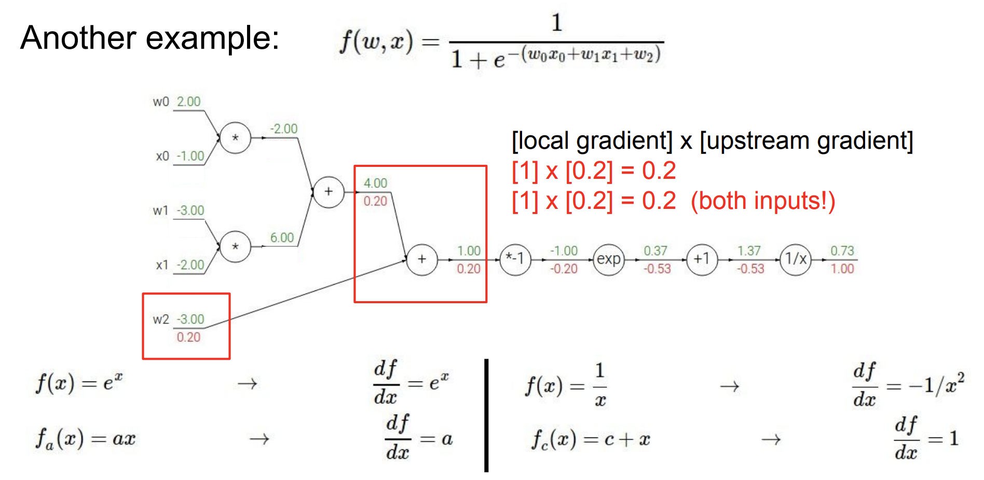
Backpropagation: Example

Slide 72
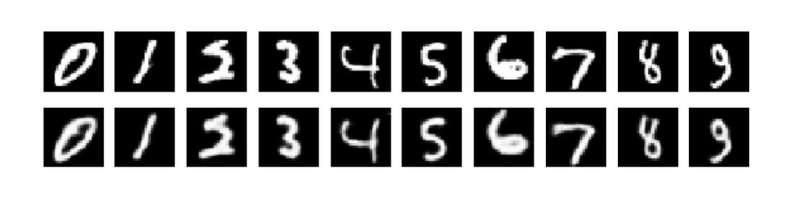
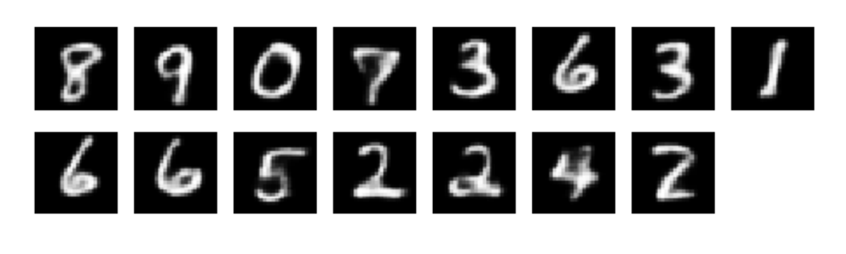
MNIST Data
Test accuracy above 99% and on par with SOTA
Reconstruction Error: 4.22
Learned prototypes:

Slide 73
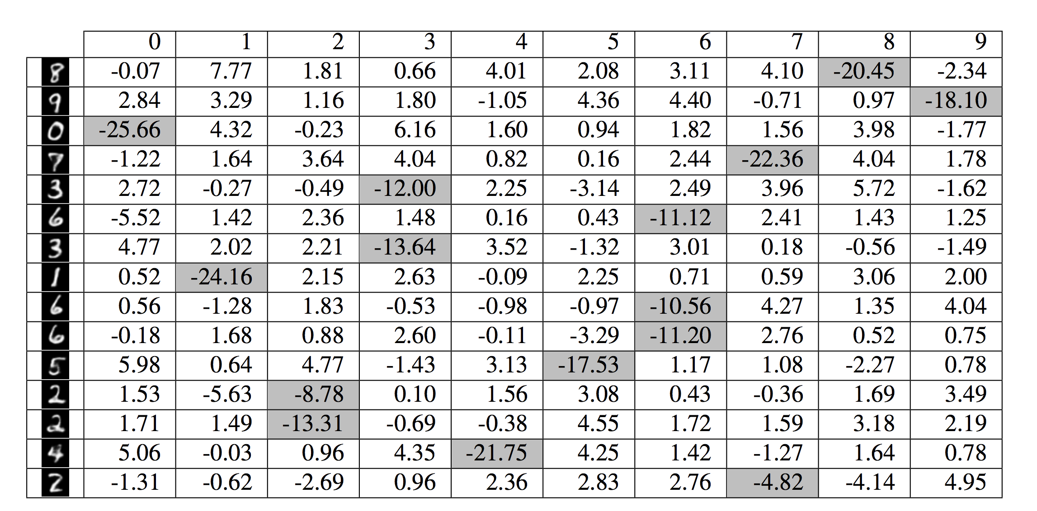
Learned Weight Matrix

Slide 74
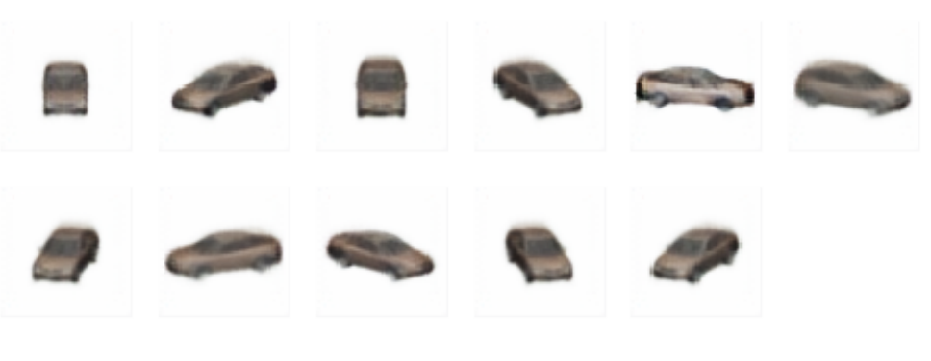
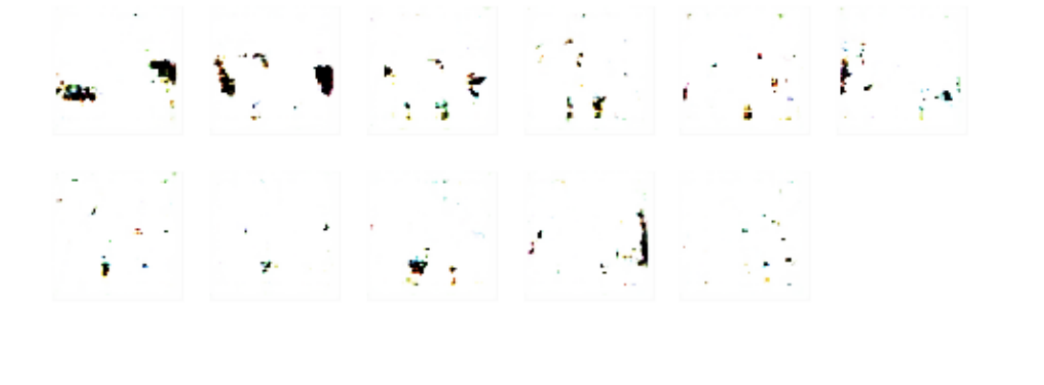
Ablation Study on Cars Data
Learned
Prototypes
Without
R₁ and R₂

Slide 75
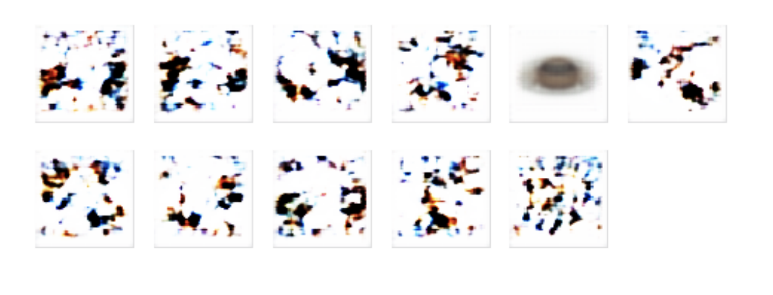
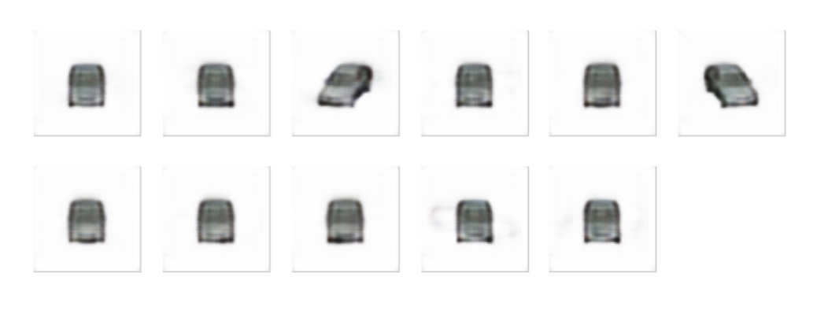
Ablation Study on Cars Data
Without
R₁
Without
R₂

